Slide 1
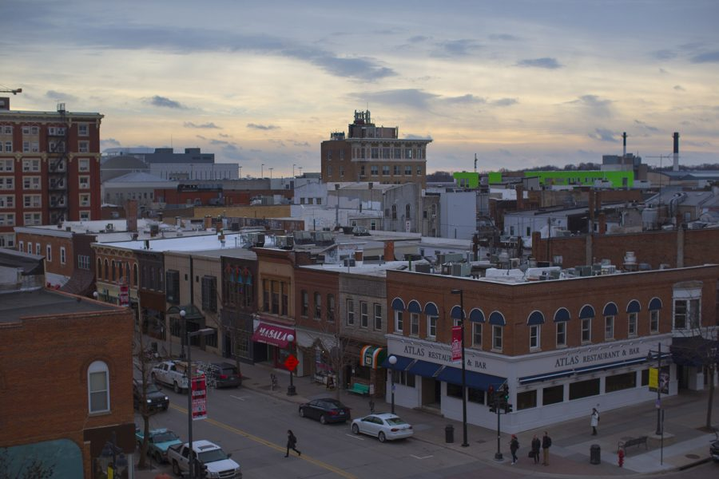
Predicting a home’s selling price in Ame’s, Iowa.
Christopher Dillard

Slide 2
What is the Ultimate Goal of the Predictive Models:
The goal here is to measure the practicality of the model. Essentially, how accurately can this model tell us whether a newly listed property will be sold above the median sales price.
In a broader sense, the model could be able to be extrapolated to other cities across the country that share similar characteristics to Ames, Iowa. But, that will be discussed later.

Slide 3
Which predictive model is appropriate?
The goal is to predict either a “Yes” or “No” for sales above the Median Price. So, we will explore the data using the following three types of predictive models for Logistic Regression:
Lasso Regression
Classification Trees
Random Forest
Pros:
Great for selecting variables when their relevance/significance might be unclear
Easy to interpret.
Pros:
- Great for analyzing non-linear relationships, ie. Non-numerical like “Neighborhood” and “Zoning type”, creating classifications.
- Great for handling mixed data types, as is our case.
Pros:
- Combines multiple classification trees to take the average of the responses in the model, sort of like a collective vote.
- Extra layer of randomness in the way data is paired, leads to more practicality for handling new data.
Cons:
Could actually exclude relevant variables when there is not a large set to choose from.
Loses strength with non-linear relationships compared to linear ones. Potential issue here.
Cons:
- Potential for Overfitting, where the model is extremely great with the data from our sample, but fails to perform as well on NEW data.
Cons:
With more layers, comes more complexity in interpreting results.
More computationally intensive then the other two models.

Slide 4
So, about the variables…
Given limitability/variation in performance for some of the models when variable selection is too limited, I will be comparing the original variable selection from Phase 1 (Above Median, Neighborhood, Year Built, Year Remodeled, Zoning Type, Lot Area, Overall Condition, Year Sold, and Year Built) with another, variable-rich selection to compare performance at the end (adding Total Rooms Above Ground, First Floor Sq. Footage, Gross Living Area, Full Bath(s), and Year Sold):
Original Dataset: “Ames_features2” and “train2” contain only the variables selected in phase 1 and its respective training set, which will be used in the models to represent a random sample of 70% of the properties in Ames.
2. Exanded Dataset: “Ames_features” and “train” represent the variable rich dataset and its training set.

Slide 5
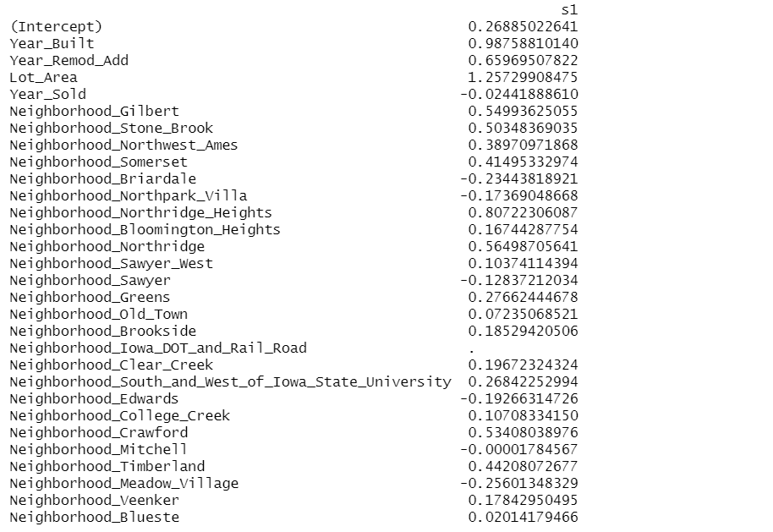
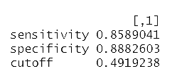
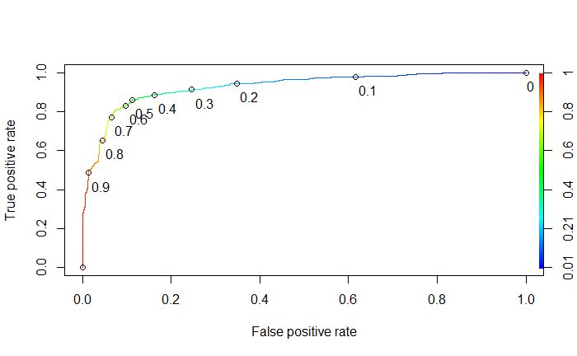
Lasso Regression Model
The Cut-off is 0.49 in the model, where values above the cutoff mean that the model will predict them to be above Median Sales Price.
The Equation Generated by the Model:
Clear Creek was eliminated by Lasso in equation.
Values for properties would be plugged into this model, with 1 meaning the property is in one of the neighborhoods and 0 being the alternative.
Some Neighborhoods have a negative impact, along with “Year_Sold”.

Slide 6
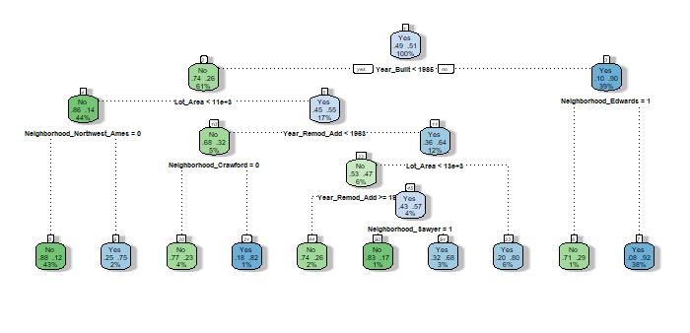
Classification Trees
The model was trained to tell us what the BEST classification tree/decision tree was for the training set, as show on the right.
First, properties are evaluated as either being built before 1986, or not.
For those that weren’t built before that year, there is another series of 7 questions, depending on if the prompted conditions are met or not.

Slide 7
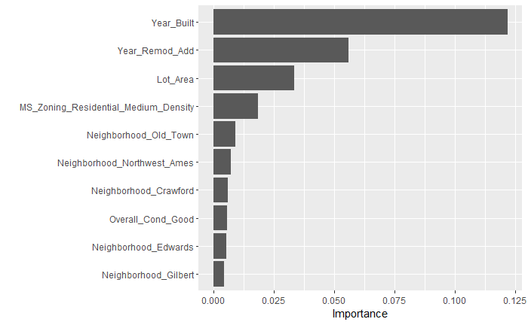
Random Forest Important Variables
The graph of the right tells us which 10 factors has the greatest importance/impact on whether a property sells above median price.
At the top is Year Built, followed by the year that remodelation was added.
Larger lot area could equate to more living space and bedrooms, which is certainly impactful.
Each Neighborhood is scored with its own level of importance, which is led by Old Town.

Slide 8
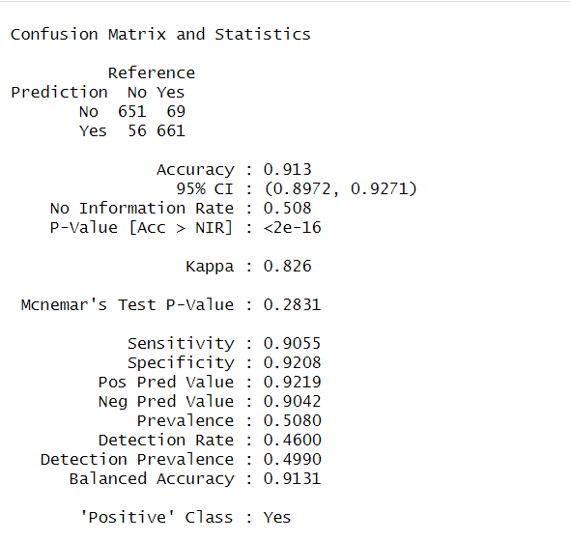
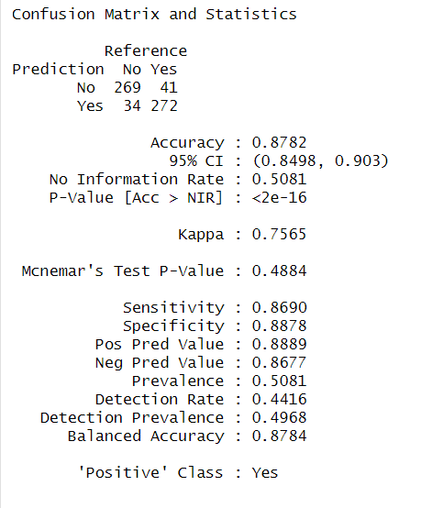
Random Forest Accuracy on Training vs. Testing:
Testing the performance on the Training Set:
Testing the Performance on the Testing Set:
By comparing the two, we can how well the model performed when seeing “new” data, since it was trained on a random sample of 70% of the original properties .
The model was slightly less accurate on the testing set, but the difference was not huge.

Slide 9
How Would Adding More Variables Affect the Model’s Accuracy?

Slide 10
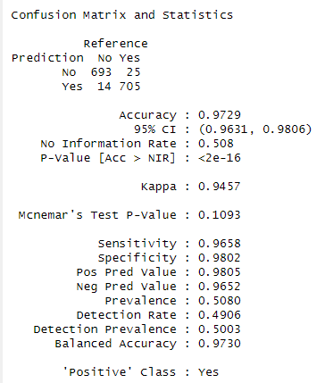
Comparing the variable importance for two Random Forest model on the training sets:
Original Dataset
Expanded Dataset
The Expanded Dataset had an accuracy of 97% while the Original Dataset had an accuracy of 91%.
Although this may sound good, it does raise the question of potential overfitting in the model ran on the Expanded dataset.

Slide 11
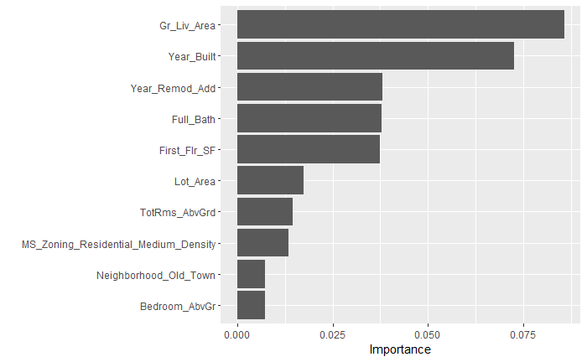
What Variables were most important in the Expanded Dataset?
Gross Living Area came on top, which is no surprise since along with more living areas come potential for:
More Bed Rooms, more Full Baths, more Total Rooms Above Ground.
These all form part of the top 10 most important factors, which points towards at least some degree of multicollinearity.

Slide 12
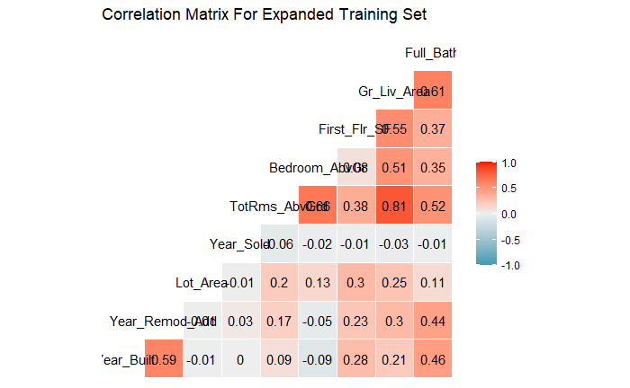
Measuring if the Variables Were Too Related to Eachother (deep reds and darker blues):
The graph to the left tells us that there was a considerable degree of correlation between the variables in the expanded data set.
In the Random Forest model, the accuracy was list as 97%, which in conjunction with evidence of multicollinearity, suggests that the model overfits the training set.
So, although the expanded dataset was more accurate in the graph, it’s accuracy when handling new property data in Ame’s would be greatly diminished.

Slide 13
What can we takeaway?
The original dataset would arguably be more useful to create predictive model for new data than the expanded dataset.
So, having more variables does not always mean the model is better even if it is more accurate with making predictions using random samples of the current data.
Neither of the two models serves any purpose for predicting the Above_Median variable in any other city, since they both use Neighborhood names which are Ames-specific.
Additionally, more city expansion could lead to the development of new Neighborhoods.

